Slide 1
Real SQL Programming
Persistent Stored Modules (PSM) PL/SQL
Embedded SQL

Slide 2
SQL in Real Programs
We have seen only how SQL is used at the generic query interface --- an environment where we sit at a terminal and ask queries of a database.
Reality is almost always different: conventional programs interacting with SQL.

Slide 3
Options
Code in a specialized language is stored in the database itself (e.g., PSM, PL/SQL).
SQL statements are embedded in a
Hostlanguage (e.g., C).
Connection tools are used to allow a conventional language to access a database (e.g., CLI, JDBC, PHP/DB).

Slide 4

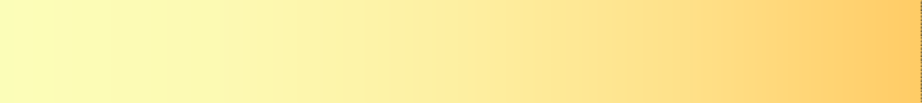

Control-of-Flow Language Elements
Example
DECLARE @n tinyint SET @n = 5
IF (@n BETWEEN 4 and 6) BEGIN
WHILE (@n > 0) BEGIN
SELECT @n AS 'Number'
,CASE
WHEN (@n % 2) = 1 THEN 'EVEN'
ELSE 'ODD' END AS 'Type'
SET @n = @n - 1 END
END ELSE
PRINT 'NO ANALYSIS'
Statement Level
BEGIN … END block
IF … ELSE block
WHILE constructs
Row Level
CASE expression

Slide 5
Stored Procedures
PSM, or “persistent stored modules,” allows us to store procedures as database schema elements.
PSM = a mixture of conventional statements (if, while, etc.) and SQL.
Lets us do things we cannot do in SQL alone.
5

Slide 6


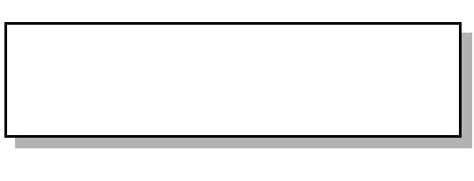

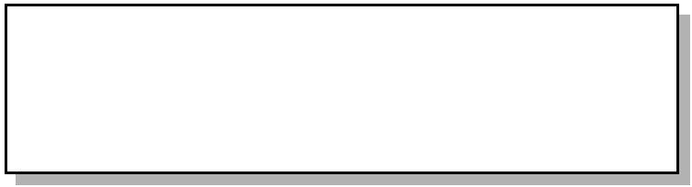


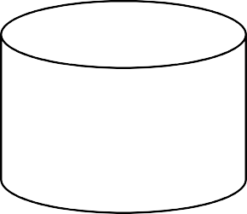



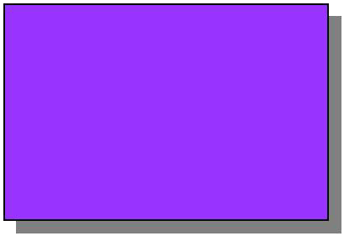

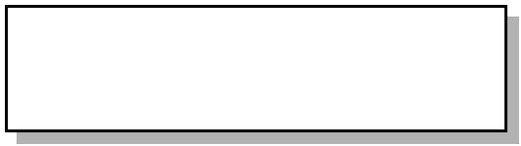





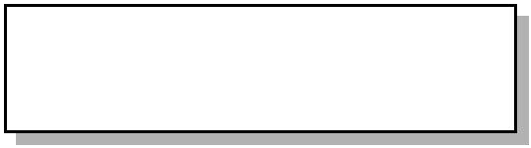


Initial Processing of Stored Procedures
Parsing
Entries into sysobjects and syscomments tables
Optimization
Compilation
Compiled plan placed in procedure cache

Slide 7
Advantages of Stored Procedures
Share Application Logic
Shield Database Schema Details
Provide Security Mechanisms
Improve Performance
Reduce Network Traffic

Slide 8






Basic PSM Form
CREATE PROCEDURE <name> (
<parameter list> )
<optional local declarations>
<body>;
Function alternative:
CREATE FUNCTION <name> (
<parameter list> ) RETURNS <type>

Slide 9










Parameters in PSM参数
Unlike the usual name-type pairs in languages like C, PSM uses mode- name-type triples, where the mode can be:
IN = procedure uses value, does not change value.
OUT = procedure changes, does not use.
INOUT = both.

Slide 10
Example: Stored Procedure
Let’s write a procedure that takes two arguments参数b and p, and adds a tuple to Sells(bar, beer, price) that has bar = ’Joe’’s Bar’, beer = b, and price = p.
Used by Joe to add to his menu more easily.

Slide 11



The Procedure
CREATE PROCEDURE JoeMenu (
IN b CHAR(20),
IN p REAL
Parameters are both read-only, not changed
)
INSERT INTO Sells
VALUES(’Joe’’s Bar’, b, p);
The body ---
a single insertion

Slide 12
Invoking调用 Procedures
Use SQL/PSM statement CALL, with the name of the desired procedure and arguments.
Example:
CALL JoeMenu(’Moosedrool’, 5.00);
Functions used in SQL expressions wherever a value of their return type is appropriate.

Slide 13
Kinds of PSM statements – (1)
RETURN <expression> sets the return value of a function.
Unlike C, etc., RETURN does not terminate终止 function execution.
DECLARE <name> <type> used to declare local variables.
BEGIN . . . END for groups of statements.
Separate statements by semicolons.

Slide 14

Kinds of PSM Statements – (2)
Assignment statements:
SET <variable> = <expression>;
Example: SET b = ’Bud’;
Statement labels: give a statement a label by prefixing a name and a colon.

Slide 15



IF Statements
Simplest form:
IF <condition> THEN
<statements(s)>
END IF;
Add ELSE <statement(s)> if desired, as IF . . . THEN . . . ELSE . . . END IF;
Add additional cases by ELSEIF
<statements(s)>: IF … THEN … ELSEIF … THEN … ELSEIF … THEN … ELSE … END IF;

Slide 16
Example: IF
Let’s rate bars by how many customers they have, based on Frequents(drinker,bar).
<100 customers: ‘unpopular’.
100-199 customers: ‘average’.
>= 200 customers: ‘popular’.
Function Rate(b) rates bar b.

Slide 17






Example: IF (continued)
CREATE FUNCTION Rate (IN b CHAR(20) )
Number of
RETURNS CHAR(10) DECLARE cust INTEGER;
customers of bar b
BEGIN
SET cust =
(SELECT COUNT(*) FROM Frequents
WHERE bar = b);
IF cust < 100 THEN RETURN ’unpopular’
ELSEIF cust < 200 THEN RETURN ’average’ ELSE RETURN ’popular’
END IF;
Nested
END;
Return occurs here, not at
IF statement
17
one of the RETURN statements

Slide 18



Loops
Basic form:
<loop name>: LOOP <statements>
END LOOP;
Exit from a loop by: LEAVE <loop name>

Slide 19
Example: Exiting a Loop
loop1: LOOP
. . .
LEAVE loop1;
. . .
END LOOP;
Control winds up here
If this statement is executed . . .

Slide 20






Other Loop Forms
WHILE <condition> DO <statements>
END WHILE;
REPEAT <statements> UNTIL <condition>
END REPEAT;

Slide 21
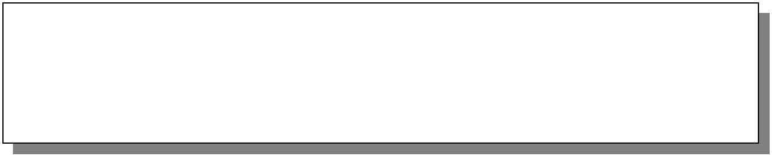
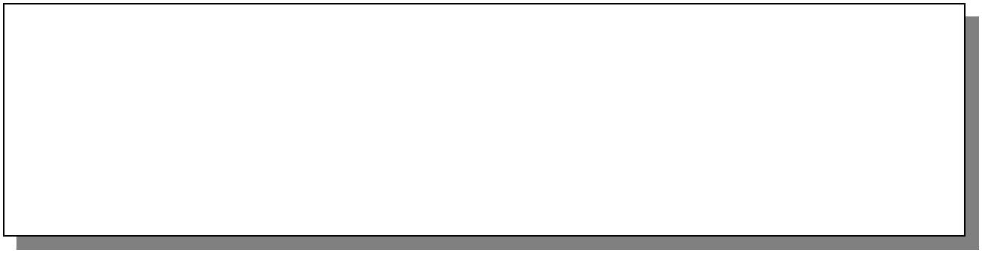
Executing Stored Procedures
Executing a Stored Procedure by Itself
EXEC OverdueOrders
Executing a Stored Procedure Within an INSERT Statement
INSERT INTO Customers EXEC EmployeeCustomer

Slide 22

Using Input Parameters
Validate 验证All Incoming Parameter Values First
Provide Appropriate Default Values and Include Null Checks
CREATE PROCEDURE dbo.[Year to Year Sales] @BeginningDate DateTime, @EndingDate DateTime
AS
IF @BeginningDate IS NULL OR @EndingDate IS NULL BEGIN
RAISERROR('NULL values are not allowed', 14, 1) RETURN
END
SELECT O.ShippedDate,
O.OrderID, OS.Subtotal,
DATENAME(yy,ShippedDate) AS Year
FROM ORDERS O INNER JOIN [Order Subtotals] OS ON O.OrderID = OS.OrderID
WHERE O.ShippedDate BETWEEN @BeginningDate AND @EndingDate

Slide 23
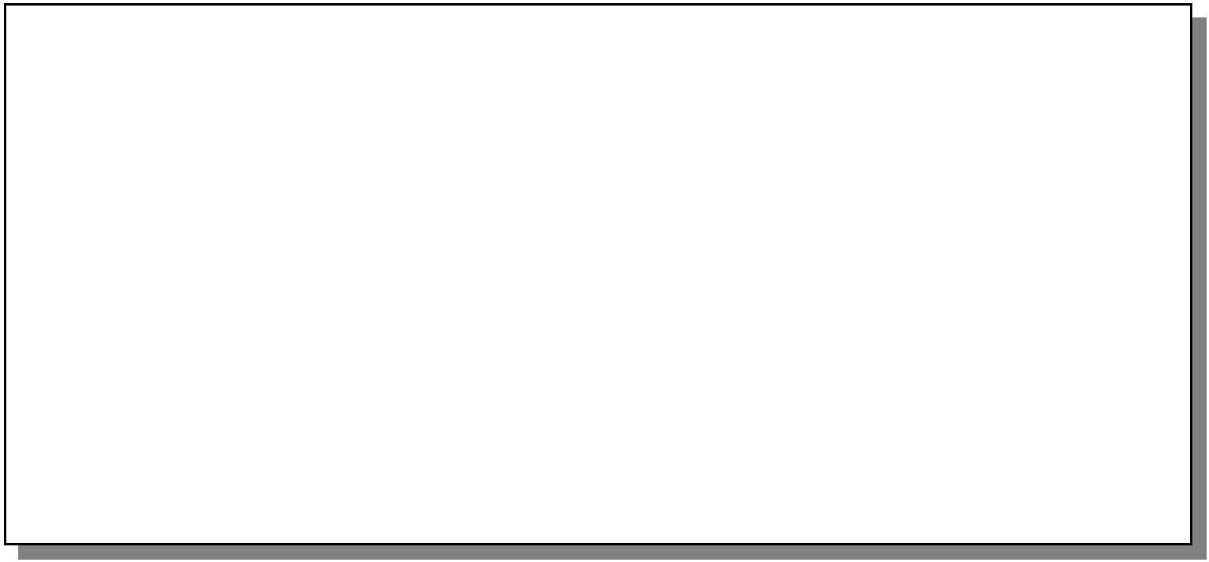
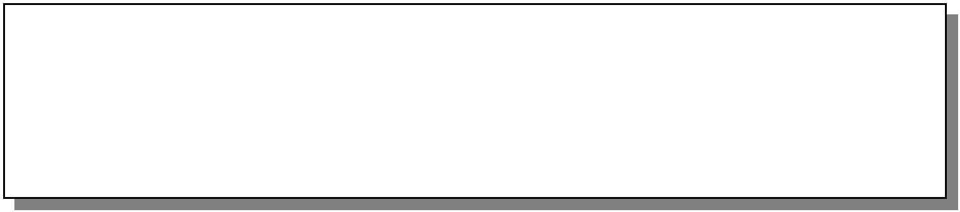


Executing Stored Procedures Using Input Parameters
Passing Values by Parameter Name
EXEC AddCustomer @CustomerID = 'ALFKI',
@ContactName = 'Maria Anders', @CompanyName = 'Alfreds Futterkiste', @ContactTitle = 'Sales Representative', @Address = 'Obere Str. 57',
@City = 'Berlin', @PostalCode = '12209', @Country = 'Germany', @Phone = '030-0074321'
Passing Values by Position
EXEC AddCustomer 'ALFKI2', 'Alfreds Futterkiste', 'Maria Anders', 'Sales Representative', 'Obere Str. 57', 'Berlin', NULL, '12209', 'Germany', '030-0074321'

Slide 24














Returning Values Using Output Parameters
CREATE PROCEDURE dbo.MathTutor @m1 smallint,
@m2 smallint,
@result smallint OUTPUT
AS
SET @result = @m1* @m2
DECLARE @answer smallint
EXECUTE MathTutor 5,6, @answer OUTPUT SELECT 'The result is: ', @answer
The result is: 30

Slide 25



Queries
General SELECT-FROM-WHERE queries are not permitted in PSM.
There are three ways to get the effect of a query:
Queries producing one value can be the expression in an assignment.
Single-row SELECT . . . INTO.
Cursors.

Slide 26
Example: Assignment/Query
Using local variable p and Sells(bar, beer, price), we can get the price Joe charges for Bud by:
SET p = (SELECT price FROM Sells
WHERE bar = ’Joe’’s Bar’ AND beer = ’Bud’);

Slide 27


SELECT . . . INTO
Another way to get the value of a query that returns one tuple is by placing INTO
<variable> after the SELECT clause.
Example:
SELECT price INTO p FROM Sells
WHERE bar = ’Joe’’s Bar’ AND beer = ’Bud’;

Slide 28


Cursors
A cursor is essentially a tuple-variable元组变量 that ranges over all tuples in the result of some query.
Declare a cursor c by:
DECLARE c CURSOR FOR <query>;

Slide 29


Opening and Closing Cursors
To use cursor c, we must issue the command:
OPEN c;
The query of c is evaluated, and c is set to point to the first tuple of the result.
When finished with c, issue command: CLOSE c;

Slide 30

Fetching Tuples获取元组 From a Cursor
To get the next tuple from cursor c, issue command:
FETCH FROM c INTO x1, x2,…,xn;
The x’s are a list of variables, one for each component of the tuples referred to by c.
c is moved automatically to the next tuple.

Slide 31
Breaking Cursor Loops – (1)
The usual way to use a cursor is to create a loop with a FETCH statement, and do something with each tuple fetched.
A tricky point is how we get out of the loop when the cursor has no more tuples to deliver.

Slide 32


Breaking Cursor Loops – (2)
Each SQL operation returns a status, which is a 5-digit character string.
For example, 00000 = “Everything OK,” and 02000 = “Failed to find a tuple.”
In PSM, we can get the value of the status in a variable called SQLSTATE.

Slide 33


Breaking Cursor Loops – (3)
We may declare a condition, which is a boolean variable that is true if and only if SQLSTATE has a particular value.
Example: We can declare condition
NotFound to represent 02000 by:
DECLARE NotFound CONDITION FOR
SQLSTATE ’02000’;

Slide 34






Breaking Cursor Loops – (4)
The structure of a cursor loop is thus:
cursorLoop: LOOP
…
FETCH c INTO … ;
IF NotFound THEN LEAVE cursorLoop;
END IF;
…
END LOOP;
34

Slide 35
Example: Cursor
Let’s write a procedure that examines Sells(bar, beer, price), and raises by $1 the price of all beers at Joe’s Bar that are under $3.
Yes, we could write this as a simple UPDATE, but the details are instructive anyway.

Slide 36
The Needed Declarations
CREATE PROCEDURE JoeGouge( )
Used to hold beer-price pairs when fetching through cursor c
DECLARE theBeer CHAR(20);
DECLARE thePrice REAL;
DECLARE NotFound CONDITION FOR SQLSTATE ’02000’;
DECLARE c CURSOR FOR
Returns Joe’s menu
(SELECT beer, price FROM Sells
WHERE bar = ’Joe’’s Bar’);

Slide 37


The Procedure Body
BEGIN
OPEN c;
menuLoop: LOOP
FETCH c INTO theBeer, thePrice;
Check if the recent FETCH failed to get a tuple
IF NotFound THEN LEAVE menuLoop END IF;
IF thePrice < 3.00 THEN
UPDATE Sells SET price = thePrice + 1.00 WHERE bar = ’Joe’’s Bar’ AND beer = theBeer;
END IF;
END LOOP; CLOSE c;
END;
If Joe charges less than $3 for the beer, raise its price at Joe’s Bar by $1.

Slide 38
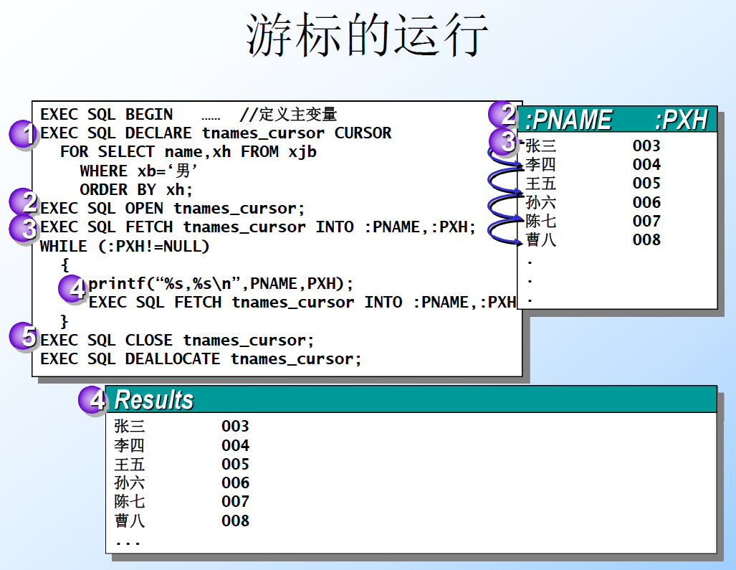

Slide 39

PL/SQL
Oracle uses a variant 变体of SQL/PSM which it calls PL/SQL.
PL/SQL not only allows you to create and store procedures or functions, but it can be run from the generic query interface泛型查询接口(sqlplus), like any SQL statement.
Triggers are a part of PL/SQL.

Slide 40
Trigger Differences
Compared with SQL standard triggers, Oracle has the following differences:
Action is a PL/SQL statement.
New/old tuples referenced automatically.
Strong constraints on trigger actions designed to make certain you can’t fire off an infinite sequence of triggers.
See on-line or-triggers.html document.

Slide 41
What Is a User-defined Function?
Scalar Functions标量函数
Similar to a built-in function内置函数
Multi-Statement Table-valued Functions多语句 表值函数
Content like a stored procedure
Referenced like a view
In-Line Table-valued Functions内联表值函数
Similar to a view with parameters
Returns a table as the result of single SELECT statement

Slide 42
Defining User-defined Functions
Creating a User-defined Function
Creating a Function with Schema Binding
Setting Permissions for User-defined Functions
Altering and Dropping User-defined Functions

Slide 43
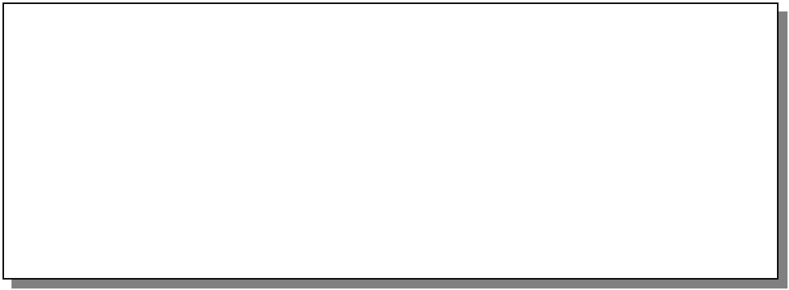
Creating a User-defined Function
Creating a Function
USE Northwind
CREATE FUNCTION fn_NewRegion (@myinput nvarchar(30)) RETURNS nvarchar(30)
BEGIN
IF @myinput IS NULL
SET @myinput = 'Not Applicable' RETURN @myinput
END
Restrictions on Functions

Slide 44
Creating a Function with Schema Binding架构绑定
Referenced User-defined Functions and Views Are Also Schema Bound
Objects Are Not Referenced with a Two- Part Name
Function and Objects Are All in the Same Database
Have Reference Permission on Required Objects

Slide 45
Setting Permissions for User- defined Functions
Need CREATE FUNCTION Permission
Need EXECUTE Permission
Need REFERENCE Permission on Cited Tables, Views, or Functions
Must Own the Function to Use in CREATE or ALTER TABLE Statement

Slide 46
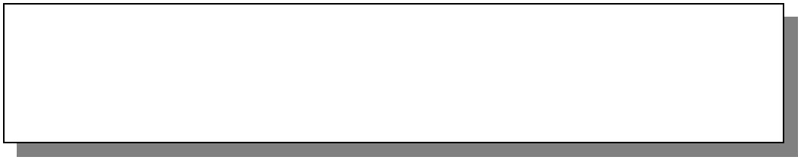
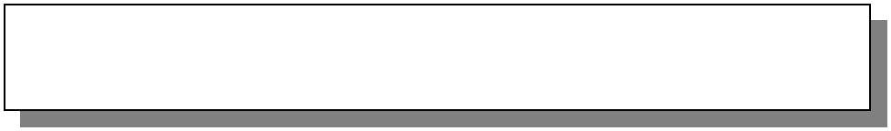


Altering and Dropping User-defined Functions
Altering Functions
ALTER FUNCTION dbo.fn_NewRegion
<New function content>
Retains assigned permissions
Causes the new function definition to replace existing definition
Dropping Functions
DROP FUNCTION dbo.fn_NewRegion

Slide 47
Examples of User-defined Functions
Using a Scalar User-defined Function
Example of a Scalar User-defined Function
Using a Multi-Statement Table-valued Function
Example of a Multi-Statement Table- valued Function
Using an In-Line Table-valued Function
Example of an In-Line Table-valued Function

Slide 48
Using a Scalar User-defined Function
RETURNS Clause Specifies Data Type
Function Is Defined Within a BEGIN and END Block
Return Type Is Any Data Type Except text, ntext, image, cursor, or timestamp

Slide 49
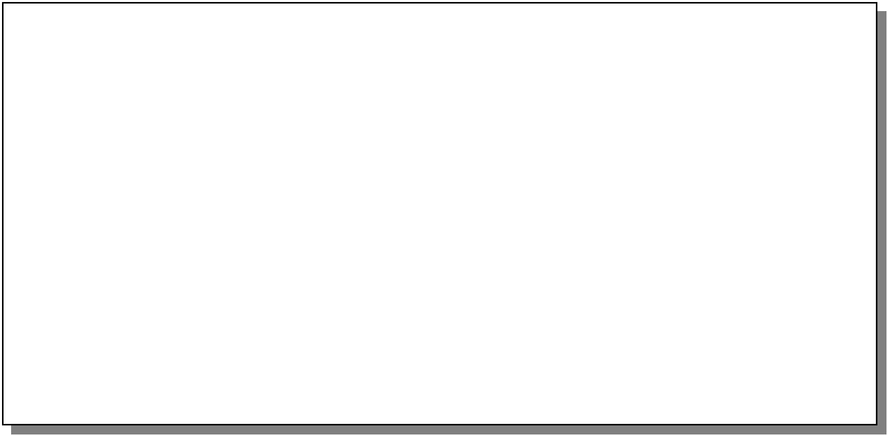
Example of a Scalar User-defined Function
Creating the Function
CREATE FUNCTION fn_DateFormat
(@indate datetime, @separator char(1)) RETURNS Nchar(20)
AS BEGIN
RETURN
CONVERT(Nvarchar(20), datepart(mm,@indate))
+ @separator
+ CONVERT(Nvarchar(20), datepart(dd, @indate))
+ @separator
+ CONVERT(Nvarchar(20), datepart(yy, @indate))
END
Calling the Function
SELECT dbo.fn_DateFormat(GETDATE(), ':')

Slide 50
Using a Multi-Statement Table- valued Function
BEGIN and END Enclose Multiple Statements
RETURNS Clause Specifies table Data Type
RETURNS Clause Names and Defines the Table

Slide 51
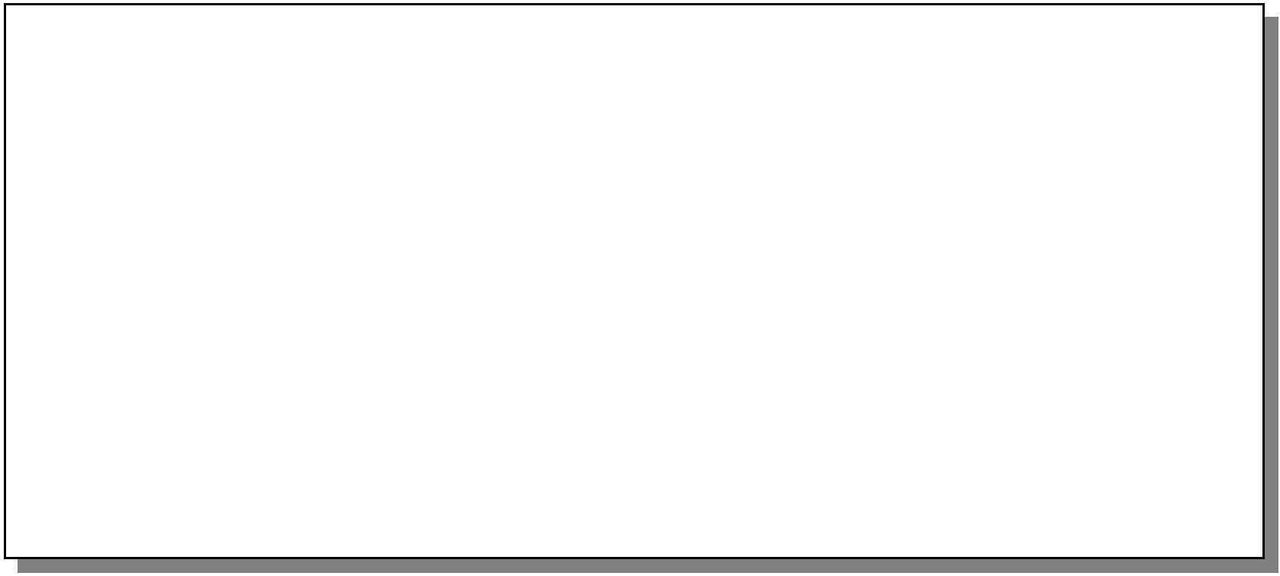
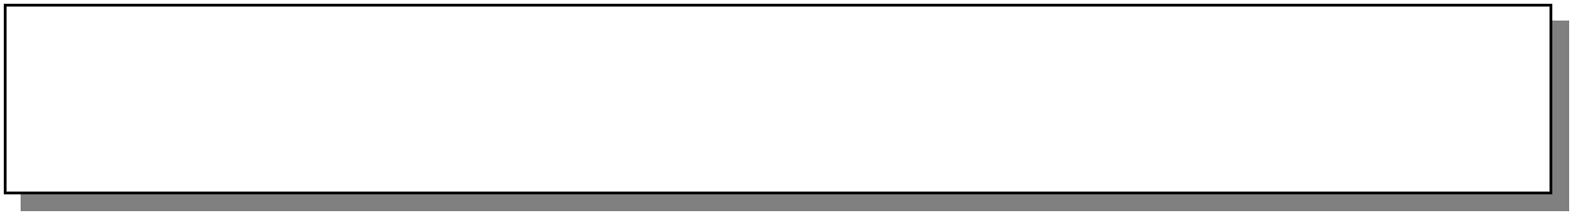
Example of a Multi-Statement Table- valued Function
Creating the Function
CREATE FUNCTION fn_Employees (@length nvarchar(9))
RETURNS @fn_Employees table
(EmployeeID int PRIMARY KEY NOT NULL, [Employee Name] nvarchar(61) NOT NULL)
AS
BEGIN
IF @length = 'ShortName'
INSERT @fn_Employees SELECT EmployeeID, LastName FROM Employees
ELSE IF @length = 'LongName'
INSERT @fn_Employees SELECT EmployeeID, (FirstName + ' ' + LastName) FROM Employees
RETURN
END
Calling the Function
SELECT * FROM dbo.fn_Employees('LongName')
Or
SELECT * FROM dbo.fn_Employees('ShortName')

Slide 52
Using an In-Line Table-valued Function
Content of the Function Is a SELECT Statement
Do Not Use BEGIN and END
RETURN Specifies table as the Data Type
Format Is Defined by the Result Set

Slide 53
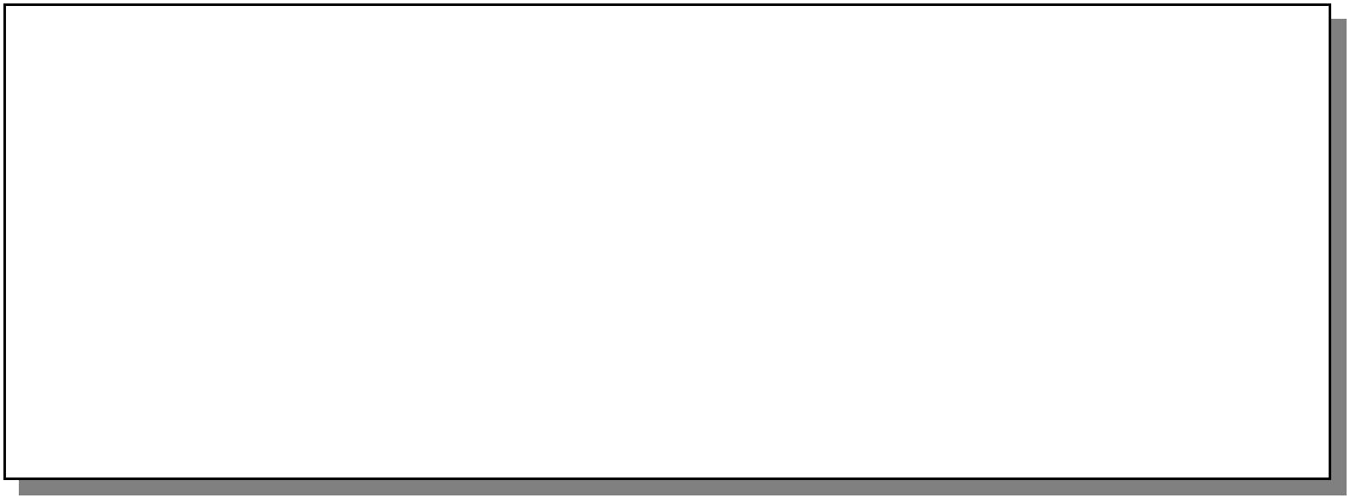
Example of an In-Line Table- valued Function
Creating the Function
CREATE FUNCTION fn_CustomerNamesInRegion ( @RegionParameter nvarchar(30) )
RETURNS table AS
RETURN (
SELECT CustomerID, CompanyName FROM Northwind.dbo.Customers WHERE Region = @RegionParameter
)
Calling the Function Using a Parameter
SELECT * FROM fn_CustomerNamesInRegion(N'WA')

Slide 54
SQLPlus
In addition to stored procedures, one can write a PL/SQL statement that looks like the body of a procedure, but is executed once, like any SQL statement typed to the generic interface.
Oracle calls the generic interface “sqlplus.”
PL/SQL is really the “plus.”

Slide 55
Form of PL/SQL Statements
DECLARE
<declarations> BEGIN
<statements>
END;
.
run
The DECLARE section is optional.

Slide 56
Form of PL/SQL Procedure
CREATE OR REPLACE PROCEDURE
<name> (<arguments>)
<optional declarations> BEGIN
AS
Notice AS needed here
<PL/SQL statements> END;
Needed to store procedure in database; does not really run it.
.
run

Slide 57
PL/SQL Declarations and Assignments
The word DECLARE does not appear in front of each local declaration.
Just use the variable name and its type.
There is no word SET in assignments, and := is used in place of =.
Example: x := y;

Slide 58
PL/SQL Procedure Parameters
There are several differences in the forms of PL/SQL argument or local- variable declarations, compared with the SQL/PSM standard:
Order is name-mode-type, not mode- name-type.
INOUT is replaced by IN OUT in PL/SQL.
Several new types.

Slide 59
PL/SQL Types
In addition to the SQL types, NUMBER can be used to mean INT or REAL, as appropriate.
You can refer to the type of attribute x
of relation R by R.x%TYPE.
Useful to avoid type mismatches.
Also, R%ROWTYPE is a tuple whose components have the types of R’s attributes.

Slide 60
Example:JoeMenu
Recall the procedure JoeMenu(b,p) that adds beer b at price p to the beers sold by Joe (in relation Sells).
Here is the PL/SQL version.

Slide 61
Procedure JoeMenu in PL/SQL
CREATE OR REPLACE PROCEDURE JoeMenu (
b IN p IN
) AS
Sells.beer%TYPE,
Sells.price%TYPE
Notice these types will be suitable
for the intended uses of band p.
BEGIN
INSERT INTO Sells
VALUES (’Joe’’s Bar’, b, p); END;
.
run
61

Slide 62
PL/SQL Branching Statements
Like IF … in SQL/PSM, but:
Use ELSIF in place of ELSEIF.
Viz.: IF … THEN … ELSIF … THEN … ELSIF … THEN … ELSE … END IF;

Slide 63
PL/SQL Loops
LOOP … END LOOP as in SQL/PSM.
Instead of LEAVE … , PL/SQL uses EXIT WHEN <condition>
And when the condition is that cursor c has found no tuple, we can write c%NOTFOUND as the condition.

Slide 64
PL/SQL Cursors
The form of a PL/SQL cursor declaration is:
CURSOR <name> IS <query>;
To fetch from cursor c, say: FETCH c INTO <variable(s)>;

Slide 65
Example: JoeGouge() in PL/SQL
Recall JoeGouge() sends a cursor through the Joe’s-Bar portion of Sells, and raises by $1 the price of each beer Joe’s Bar sells, if that price was initially under $3.

Slide 66
Example: JoeGouge() Declarations
CREATE OR REPLACE PROCEDURE
JoeGouge() AS
theBeer Sells.beer%TYPE; thePrice Sells.price%TYPE; CURSOR c IS
SELECT beer, price FROM Sells WHERE bar = ’Joe’’s Bar’;

Slide 67
Example: JoeGouge() Body
BEGIN
OPEN c;
LOOP
FETCH c INTO theBeer, thePrice;
How PL/SQL breaks a cursor loop
EXIT WHEN c%NOTFOUND;
IF thePrice < 3.00 THEN UPDATE Sells
SET price = thePrice + 1.00;
WHERE bar = ’Joe’’s Bar’ AND beer = theBeer; END IF;
END LOOP; CLOSE c;
END;
Note this is a SET clause
in an UPDATE, not an assignment. PL/SQL uses := for assignments.
67

Slide 68
Tuple-Valued Variables
PL/SQL allows a variable x to have a tuple type.
x R%ROWTYPE gives x the type of R’s tuples.
Rcould be either a relation or a cursor.
x.a gives the value of the component for attribute a in the tuple x.

Slide 69
Example: Tuple Type
Repeat of JoeGouge() declarations with variable bp of type beer-price pairs.
CREATE OR REPLACE PROCEDURE
JoeGouge() AS CURSOR c IS
SELECT beer, price FROM Sells WHERE bar = ’Joe’’s Bar’;
bp c%ROWTYPE;

Slide 70
JoeGouge() Body Using bp
BEGIN
OPEN c; LOOP
FETCH c INTO bp;
EXIT WHEN c%NOTFOUND; IF < 3.00 THEN
bp.price
UPDATE Sells SET price = + 1.00 WHERE bar = ’Joe’’s Bar’ AND beer =
bp.price
bp.beer
;
END IF; END LOOP; CLOSE c;
END;
Components of bp are obtained with a dot and the attribute name
70

Slide 71
Embedded SQL
Key idea: A preprocessor turns SQL statements into procedure calls that fit with the surrounding host-language code.
All embedded SQL statements begin with EXEC SQL, so the preprocessor can find them easily.

Slide 72
Shared Variables
To connect SQL and the host-language program, the two parts must share some variables.
Declarations of shared variables are bracketed by:
BEGIN DECLARE SECTION;
EXEC SQL
Always needed
<host-language declarations>
EXEC SQL
END DECLARE SECTION;

Slide 73
Use of Shared Variables
In SQL, the shared variables must be preceded by a colon.
They may be used as constants provided by the host-language program.
They may get values from SQL statements and pass those values to the host-language program.
In the host language, shared variables behave like any other variable.

Slide 74
Example: Looking Up Prices
We’ll use C with embedded SQL to sketch the important parts of a function that obtains a beer and a bar, and looks up the price of that beer at that bar.
Assumes database has our usual Sells(bar, beer, price) relation.

Slide 75
Example: C Plus SQL
EXEC SQL BEGIN DECLARE SECTION;
Note 21-char arrays needed for 20 chars + endmarker
char ;
float thePrice;
EXEC SQL END DECLARE SECTION;
theBar[21], theBeer[21]
/* obtain values for theBar and theBeer */ EX
EC SQL SELECT price INTO :thePrice
FROM Sells
WHERE bar = :theBar AND beer = :theBeer;
/* do something with thePrice */
SELECT-INTO
as in PSM
75

Slide 76
Embedded Queries
Embedded SQL has the same limitations as PSM regarding queries:
SELECT-INTO for a query guaranteed to produce a single tuple.
Otherwise, you have to use a cursor.
Small syntactic differences, but the key ideas are the same.

Slide 77
Cursor Statements
Declare a cursor cwith:
EXEC SQL DECLARE c CURSOR FOR <query>;
Open and close cursor c with:
EXEC SQL OPEN CURSOR c; EXEC SQL CLOSE CURSOR c;
Fetch from c by:
EXEC SQL FETCH c INTO <variable(s)>;
Macro NOT FOUND is true if and only if the FETCH fails to find a tuple.

Slide 78
Example: Print Joe’s Menu
Let’s write C + SQL to print Joe’s menu
– the list of beer-price pairs that we find in Sells(bar, beer, price) with bar = Joe’s Bar.
A cursor will visit each Sells tuple that has bar = Joe’s Bar.

Slide 79
Example: Declarations
EXEC SQL BEGIN DECLARE SECTION;
char theBeer[21]; float thePrice; EXEC SQL END DECLARE SECTION;
EXEC SQL DECLARE c CURSOR FOR
SELECT beer, price FROM Sells WHERE bar = ’Joe’’s Bar’;
The cursor declaration goes outside the declare-section

Slide 80
Example: Executable Part
EXEC SQL OPEN CURSOR c;
The C style of breaking loops
while(1)
{
EXEC SQL FETCH c
INTO :theBeer, :thePrice;
/* format and print theBeer and thePrice */
}
EXEC SQL CLOSE CURSOR c;
if (NOT FOUND) break;

Slide 81
Need for Dynamic SQL
Most applications use specific queries and modification statements to interact with the database.
The DBMS compiles EXEC SQL … statements into specific procedure calls and produces an ordinary host-language program that uses a library.
What about sqlplus, which doesn’t know what it needs to do until it runs?

Slide 82
Dynamic SQL
Preparing a query:
EXEC SQL PREPARE <query-name> FROM <text of the query>;
Executing a query:
EXEC SQL EXECUTE <query-name>;
“Prepare” = optimize query.
Prepare once, execute many times.

Slide 83
Example: A Generic Interface
EXEC SQL BEGIN DECLARE SECTION;
char query[MAX_LENGTH];
EXEC SQL END DECLARE SECTION;
while(1) {
/* issue SQL> prompt */
/* read user’s query into array query */
EXEC SQL PREPARE FROM :query; EXEC SQL EXECUTE ;
q
q
q is an SQL variable representing the optimized form of whatever statement
}
is typed into :query
83

Slide 84
Execute-Immediate
If we are only going to execute the query once, we can combine the PREPARE and EXECUTE steps into one.
Use:
EXEC SQL EXECUTE IMMEDIATE <text>;

Slide 85
Example: Generic Interface Again
EXEC SQL BEGIN DECLARE SECTION;
char query[MAX_LENGTH]; EXEC SQL END DECLARE SECTION;
while(1) {
query */
EXEC SQL EXECUTE IMMEDIATE :query;
}
/* | issue | SQL> | prompt | */
/* | read | user’s | query | into | array

